Slide 1
ICT UNIVERSITY FINAL EXAMINATION ADVANCED WEB DEVELOPMENT
Project Build a Booking Event Web application
Present by: ONDOA Ondoa Etienne Materne
L3 online student software engineering
Matricule: ICTU20233886

Slide 2
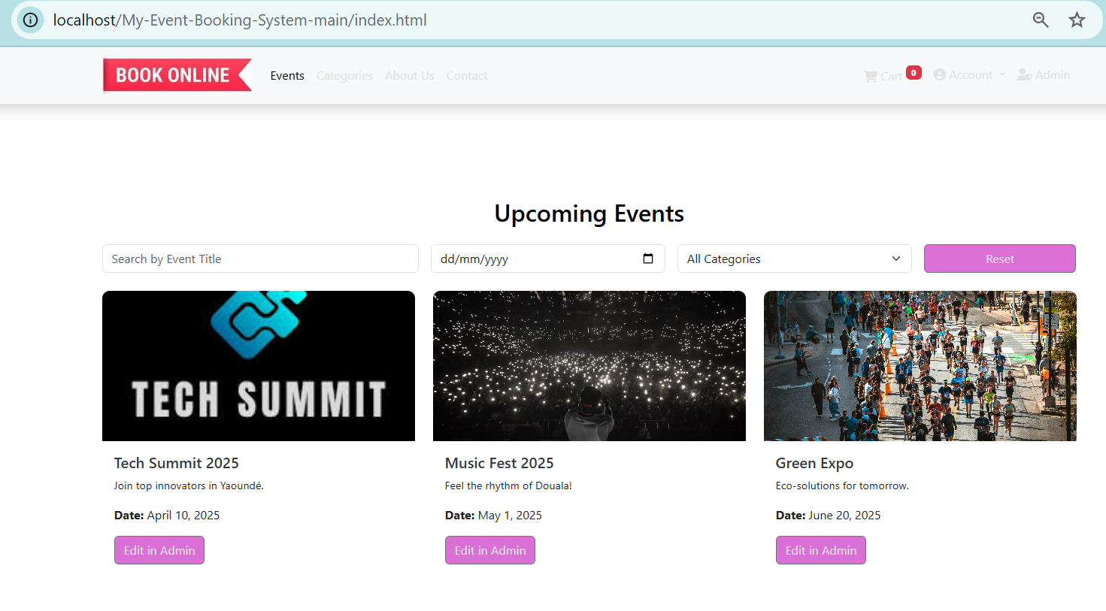
Goal: Develop a fully functional system for browsing, searching, and booking event tickets.
Technologies:
Front End: HTML, CSS, Bootstrap
Client-Side: JavaScript
Server-Side: PHP, MySQL

Slide 3
Key Features
User Authentication: Sign-up, login, profile management
Event Listings Page: Catalogue with event details
Search Functionality: Search bar and filters
Event Details Page: Detailed info and booking button
Booking Cart: Add, update, remove tickets
Checkout Process: Payment and confirmation
Booking History: Dashboard with past/upcoming bookings
Admin Panel: Manage events and generate reports
Documentation: Overview, design, implementation, user manual

Slide 4
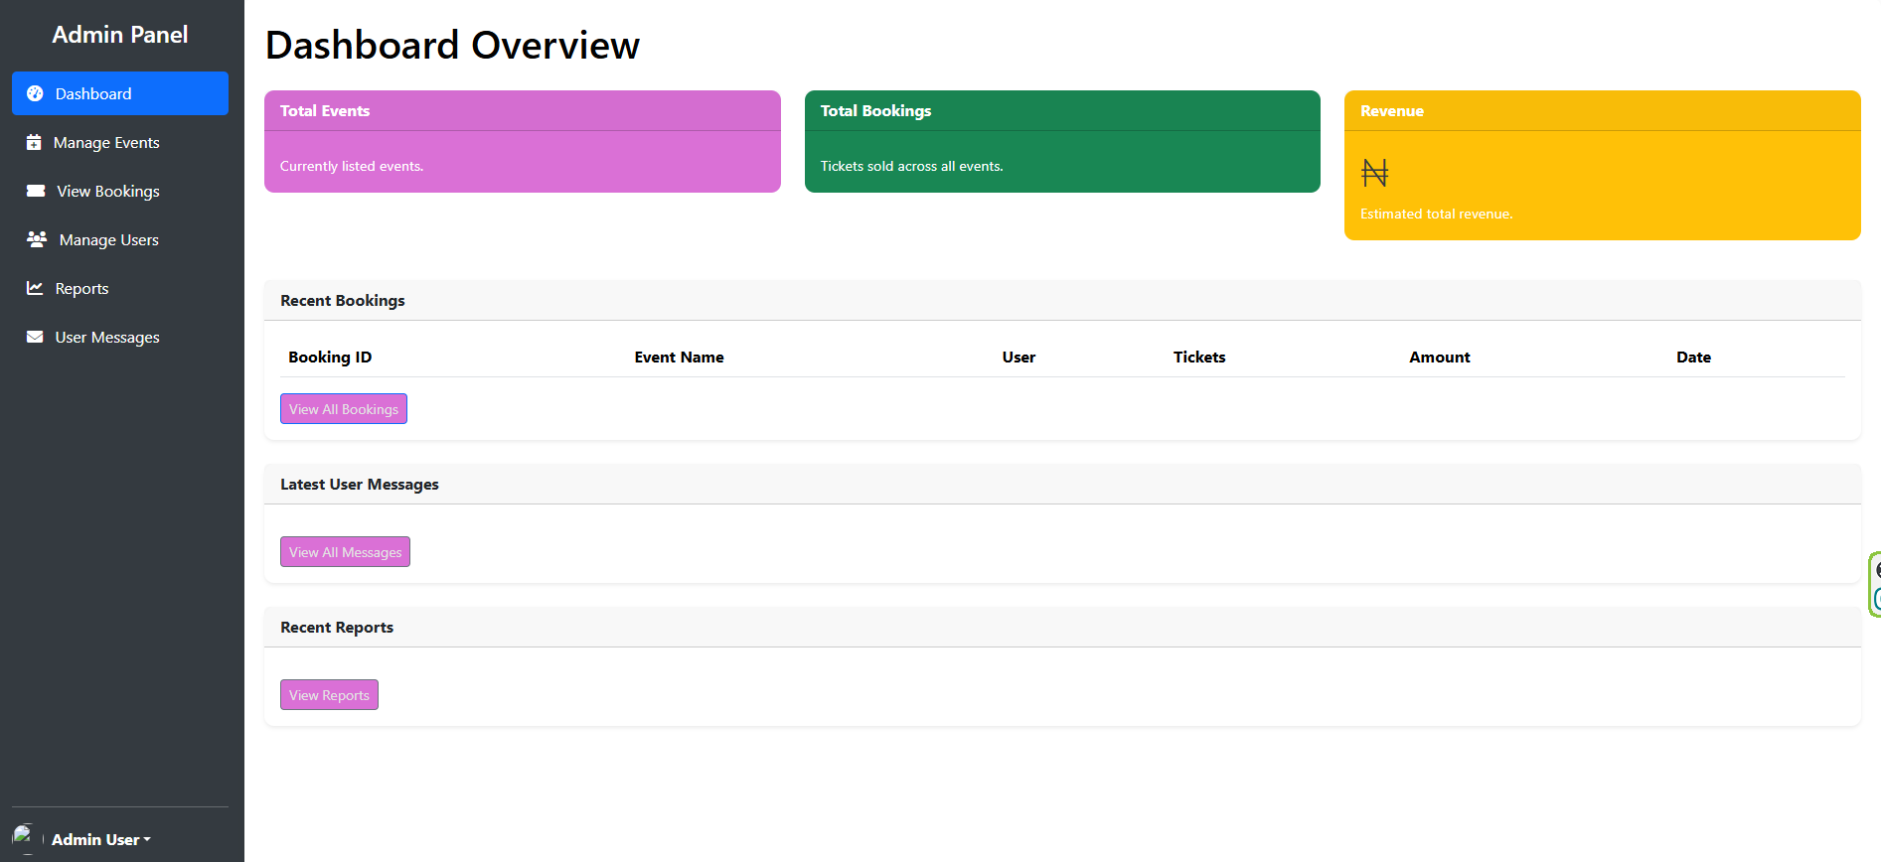

Slide 5
Implementation Highlights
Front End: Responsive design using Bootstrap
Back End: PHP for logic, MySQL for database
Interactivity: JavaScript for dynamic updates
Admin Features: CRUD(CRUD stands for Create, Read, Update, Delete) operations and reporting

Slide 6
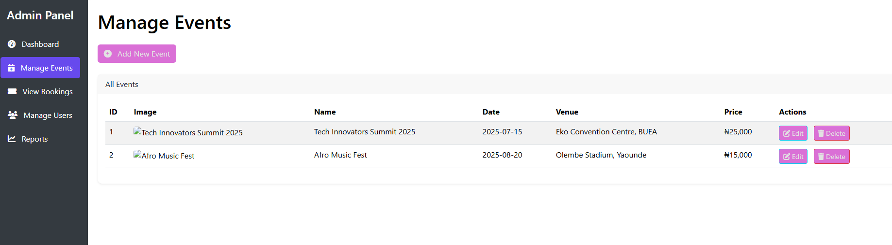

Slide 7
Challenges & Solutions
Challenge: Ensuring secure user authentication
Solution: Implemented session management and input validation, The building is still in progress
Challenge: Real-time cart updates
Solution: Used JavaScript for seamless updates, will always be done
Challenge: My computer crash and I have to start again yesterday night
Solution: Will do backup in Github and Google drive as I move with the project.
Challenge: Some features are not fully working
Solution: Dvelopment is still in progress

Slide 8
Demo
Live Demo: Show event listing, search, booking process
Admin Panel: Add an event and view bookings

Slide 9
Conclusion
Summary: A robust system meeting all project requirements
Future Work: Update all the features so that they can communicate well, Adapt with other technology can improve UI friendly, Add payment gateway integration, mobile app.
Thank You: Questions?

Slide 10
References
Course Material: SEN3243 - Advanced Web Development
Bootstrap Documentation
PHP & MySQL Guides

